Slide 1
Ethics in Information Technology, Fourth Edition
Chapter 2
Ethics for IT Workers and IT Users

Slide 2
Objectives
As you read this chapter, consider the following questions:
  What key characteristics distinguish a professional from other kinds of workers, and is an IT worker considered a professional?
  What factors are transforming the professional services industry?
  What relationships must an IT worker manage, and what key ethical issues can arise in each?
Ethics in Information Technology, Fourth Edition
Notes:
professional : مهني
distinguish : تميز
factors : العوامل
transforming تحويل
arise : نشأ , ظهر

Slide 3
Objectives (cont’d.)
  How do codes of ethics, professional organizations, certification, and licensing affect the ethical behavior of IT professionals?
  What is meant by compliance, and how does it help promote the right behaviors and discourage undesirable ones?
Ethics in Information Technology, Fourth Edition
Notes:
Compliance: الامتثال

Slide 4
IT Professionals
Profession is a calling that requires:
  Specialized knowledge
  Long and intensive academic preparation
Professionals-US Code of Federal Regulation:
  Require advanced training and experience
  Must exercise discretion and judgment in their work
  Contribute to society, participate in lifelong training, assist other professionals
  Carry special rights and responsibilities
Ethics in Information Technology, Fourth Edition

Slide 5
Are IT Workers Professionals?
Partial list of IT specialists
  Programmers
  Systems analysts
  Software engineers
  Database administrators
  Local area network (LAN) administrators
  Chief information officers (CIOs)
Ethics in Information Technology, Fourth Edition

Slide 6
Are IT Workers Professionals?
(cont’d.)
not every IT role requires “knowledge of an advanced type in a field of science or learning customarily acquired by a prolonged course of specialized intellectual instruction and study,”
Legal perspective
  IT workers do not meet legal definition of professional
    Not licensed by state or federal government
    Not liable for malpractice
Ethics in Information Technology, Fourth Edition
Notes:
Legal perspective: منظور قانوني

Slide 7
The Changing Professional Services Industry
Although not legally classified as professionals, IT workers are considered part of the professional services industry, which is experiencing immense changes that impact how members of this industry must think and behave to be successful.
Ethics in Information Technology, Fourth Edition

Slide 8
The Changing Professional Services Industry
IT workers are considered part of the professional services industry
Seven forces are changing professional services
  Client sophistication (able to drive hard bargains)
  Governance (due to major scandals- less trust-more oversight)
  Connectivity (instant communications)
  Transparency (view work-in-progress in real-time)
  Modularization (able to outsource modules)
  Globalization (worldwide sourcing-competitivness)
  Commoditization (for low-end services)
Ethics in Information Technology, Fourth Edition
Notes:
The Changing Professional Services Industry:
Forces:
Sophistication: تطور
Bargains: الصفقات
Governance: الحكم,
Scandals : فضائح
Connectivity : الاتصال // instant communications : الاتصالات الفورية
Transparency : شفافية
Modularization : تقنينها, البنيوية // able to outsource modules:
Globalization : العولمة , عالمي
Commoditization : سلع استهلاكية

Slide 9
Professional Relationships That Must Be Managed
IT workers involved in relationships with:
  Employers
  Clients
  Suppliers
  Other professionals
  IT users
  Society at large
Ethics in Information Technology, Fourth Edition
Notes:
Society at large: المجتمع ككل

Slide 10
1. Relationships Between
IT Workers and Employers
IT workers agree on many aspects of work relationship before workers accept job offer
Other aspects of work relationship defined in company’s policy and procedure manual or code of conduct
Some aspects develop over time
As steward of organization’s IT resources, IT workers must set an example and enforce policies regarding the ethical use of IT in:
Ethics in Information Technology, Fourth Edition
Notes:
accept : قبل , وافق
aspects : الجوانب, النواحي
code of conduct: مدونة لقواعد السلوك
steward : منظم

Slide 11
Relationships Between
IT Workers and Employers
  Software piracy
  Act of illegally making copies of software or enabling access to software to which they are not entitled
  Area in which IT workers can be tempted to violate laws and policies
  2007, 38% software was copied ilegaly,48$ billion loss for manufacturer, distributors and service providers
  Government loses sales tax revenue
Ethics in Information Technology, Fourth Edition
Notes:
Piracy: قرصنة,
Entitled: المعنون, بعنوان
tempted : يغري, اغراء
violate : انتهاك
Alliance : تحالف
Trade: التجارة // trade group:مجموعة تجارية
representing : تمثل
prosecuted : محاكمة

Slide 12
Relationships Between
IT Workers and Employers (cont’d)
  Software piracy
  The Business Software Alliance (BSA) is a trade group representing the world’s largest software and hardware manufacturers; mission is to stop the unauthorized copying of software
  Thousands of cases prosecuted each year(2500 reports)
  “know it, report it, reward it”
  BSA is funded by member companies and also through settlements of cases
Ethics in Information Technology, Fourth Edition
Notes:
Piracy: قرصنة,
Entitled: المعنون, بعنوان
tempted : يغري, اغراء
violate : انتهاك
Alliance : تحالف
Trade: التجارة // trade group:مجموعة تجارية
representing : تمثل
prosecuted : محاكمة

Slide 13
Relationships Between
IT Workers and Employers (cont’d)
In 2009, XMCO, a Michigan-based subsidiary of Koniag Development Corporation that writes and produces technical manuals for military equipment and vehicles, paid BSA $70,000 to settle a claim that it had installed unlicensed copies of Adobe, Corel, and Microsoft software on its computers. XMCO agreed to delete all unlicensed copies of software, buy the necessary number of licenses to become compliant, and commit itself to implementing improved practices for managing software licenses.
Why settlement ?
Ethics in Information Technology, Fourth Edition
Notes:
Piracy: قرصنة,
Entitled: المعنون, بعنوان
tempted : يغري, اغراء
violate : انتهاك
Alliance : تحالف
Trade: التجارة // trade group:مجموعة تجارية
representing : تمثل
prosecuted : محاكمة

Slide 14
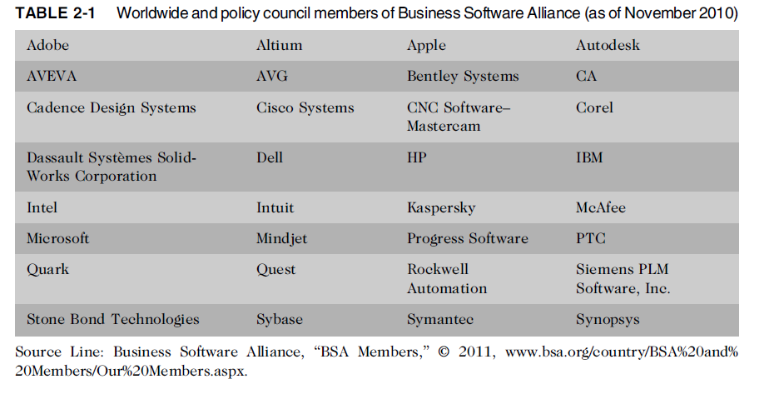
Relationships Between
IT Workers and Employers (cont’d.)
http://www.bsa.org/country/BSA%20and%20Members/Our%20Members.aspx
Ethics in Information Technology, Fourth Edition
Notes:
www.bsa.org/country/BSA%20and%20Members/Our%20Members.aspx
Worldwide and policy council members of Business Software Alliance (BSA)

Slide 15
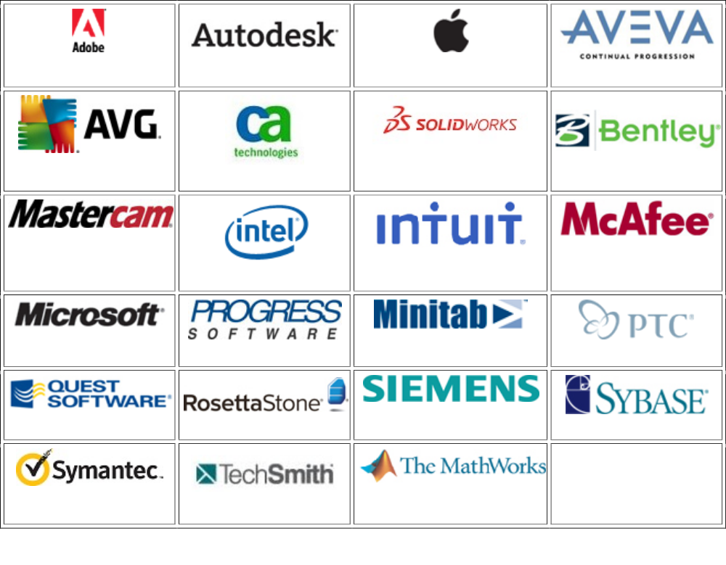
Ethics in Information Technology, Fourth Edition
Worldwide and policy council members of Business Software Alliance (BSA)

Slide 16
Relationships Between
IT Workers and Employers (cont’d.)
Software piracy – Civil and Criminal penalties
IT workers must set an example and enforce policies regarding the ethical use of IT in: (cont’d.)
  Trade secrets
    Business information generally unknown to public
    Company takes actions to keep confidential
    Require cost or effort to develop
    Have some degree of uniqueness or novelty
    Design of a software code, hardware designs, business plans, design of a UI etc
Ethics in Information Technology, Fourth Edition
Notes:
Trade secrets:الأسرار التجارة
uniqueness : تميز // novelty: إبداع
attracts : يجذب // negligent: مهمل // illegal: غير شرعي// abusive: متعسف, مؤذ جسديا, بذيء
threatens : يهدد // interest: مصلحة

Slide 17
Relationships Between
IT Workers and Employers (cont’d.)
  Trade secrets
  In September 2006, a vice president of HP’s printer division was fired from his new job after just four months. Shortly after his employment began with HP, he e-mailed confidential information from his former employer, IBM, to two senior vice presidents at HP. The information was marked confidential on each page and included product costs and material data that could help the HP sales team understand the goals of IBM. HP quickly investigated, fired the employee, and reported him to IBM and law enforcement authorities. He faces a possible sentence of 10 years’ imprisonment and a $250,000 fine.
Ethics in Information Technology, Fourth Edition
Notes:
Trade secrets:الأسرار التجارة
uniqueness : تميز // novelty: إبداع
attracts : يجذب // negligent: مهمل // illegal: غير شرعي// abusive: متعسف, مؤذ جسديا, بذيء
threatens : يهدد // interest: مصلحة

Slide 18
Relationships Between
IT Workers and Employers (cont’d.)
IT workers must set an example and enforce policies regarding the ethical use of IT in: (cont’d.)
  Whistle-blowing
    Employee attracts attention to a negligent, illegal, unethical, abusive, or dangerous act that threatens the public interest
    For example, an employee of a chip manufacturing company may know that the chemical process used to make the chips is dangerous to employees and the general public.
Ethics in Information Technology, Fourth Edition
Notes:
Trade secrets:الأسرار التجارة
uniqueness : تميز // novelty: إبداع
attracts : يجذب // negligent: مهمل // illegal: غير شرعي// abusive: متعسف, مؤذ جسديا, بذيء
threatens : يهدد // interest: مصلحة

Slide 19
Relationships Between
IT Workers and Employers (cont’d.)
  Whistle-blowing
  In May 2005, Oracle Corporation paid $8 million to settle charges that it fraudulently collected fees before providing training for clients and failed to comply with federal travel regulations in billing for travel and expenses. The charges arose from a whistle-blower lawsuit brought by a former Oracle vice president. As a result of the settlement, the whistleblower received $1.58 million of the $8 million total settlement.
Ethics in Information Technology, Fourth Edition
Notes:
Trade secrets:الأسرار التجارة
uniqueness : تميز // novelty: إبداع
attracts : يجذب // negligent: مهمل // illegal: غير شرعي// abusive: متعسف, مؤذ جسديا, بذيء
threatens : يهدد // interest: مصلحة

Slide 20
2. Relationships Between
IT Workers and Clients
IT worker provides:
  Hardware, software, or services at a certain cost and within a given time frame
Client provides:
  Compensation
  Access to key contacts
  Work space
Relationship is usually documented in contractual terms
Ethics in Information Technology, Fourth Edition
Notes:
Compensation: تعويضات, الراتب
Access to key contacts: الوصول إلى جهات الاتصال الرئيسية
Work space: مكان العمل

Slide 21
Relationships Between
IT Workers and Clients (cont’d.)
Client makes decisions about a project based on information, alternatives, and recommendations provided by the IT worker
Client trusts IT worker to act in client’s best interests
IT worker trusts that client will provide relevant information, listen to and understand what the IT worker says, ask questions to understand impact of key decisions, and use the information to make wise choices
Responsibility of decision making is shared
Ethics in Information Technology, Fourth Edition

Slide 22
Relationships Between
IT Workers and Clients (cont’d.)
Ethical problems arise if a company recommends its own products and services to remedy problems they have detected
  Creates a conflict of interest
Problems arise during a project if IT workers are unable to provide full and accurate reporting of a project’s status
  Finger pointing and heated discussions can ensue
Ethics in Information Technology, Fourth Edition

Slide 23
Relationships Between
IT Workers and Clients (cont’d.)
Fraud
  Crime of obtaining goods, services, or property through deception or trickery
    The wrongdoer made a false representation of material fact.
    The wrongdoer intended to deceive the innocent part
    The innocent party justifiably relied on the misrepresentation.
    The innocent party was injured.
Misrepresentation
  Misstatement or incomplete statement of material fact
  If misrepresentation causes a party to enter into a contract, that party may have the right to cancel contract or seek reimbursement for damages
Ethics in Information Technology, Fourth Edition

Slide 24
Relationships Between
IT Workers and Clients (cont’d.)
Misrepresentation
  As an example of misrepresentation, an Oracle marketing campaign claimed that retail companies using its software are “49.7 percent more profitable and 61.5 percent more capital efficient than peers.” The statement was based on analysis performed by Oracle on data provided by Stratascope, a market research firm. The Stratascope CEO demanded that Oracle issue a correction, claiming, “We have no knowledge of the validity of the criteria and the methodology [Oracle] used, particularly because several of its claims are based on a set of data we do not possess.”
Ethics in Information Technology, Fourth Edition

Slide 25
Relationships Between
IT Workers and Clients (cont’d.)
Breach of contract
  One party fails to meet the terms of a contract
  When there is material breach of contract:
    The non-breaching party may rescind the contract, seek restitution of any compensation paid to the breaching party, and be discharged from any further performance under the contract
When IT projects go wrong because of cost overrun, schedule slippage, lack of system functionality-aggrieved party might charge fraud, fraudulent misinterpretation or breach of contract
  Such matters are settled outside of court – why?
Ethics in Information Technology, Fourth Edition
Notes:
Breach of contract : الإخلال بالعقد
One party fails : فشل طرف واحد
non-breaching: غير المخل // rescind : فسخ // restitution :تعويض //compensation : تعويضات
discharged : غير مكلف
further performance: مزيد من الأداء
vendors : البائعين
assign : حدد

Slide 26
Relationships Between
IT Workers and Clients (cont’d.)
Breach of contract
  IT projects are joint efforts in which vendors and customers work together
  When there are problems, it is difficult to assign who is at fault
    The customer changes the scope of the project or the system requirements.
    Poor communication between customer and vendor leads to performance that does not meet expectations.
    The vendor delivers a system that meets customer requirements, but a competitor comes out with a system that offers more advanced and useful features.
    The customer fails to reveal information about legacy systems or databases that make the new system extremely difficult to implement.
Ethics in Information Technology, Fourth Edition
Notes:
Breach of contract : الإخلال بالعقد
One party fails : فشل طرف واحد
non-breaching: غير المخل // rescind : فسخ // restitution :تعويض //compensation : تعويضات
discharged : غير مكلف
further performance: مزيد من الأداء
vendors : البائعين
assign : حدد

Slide 27
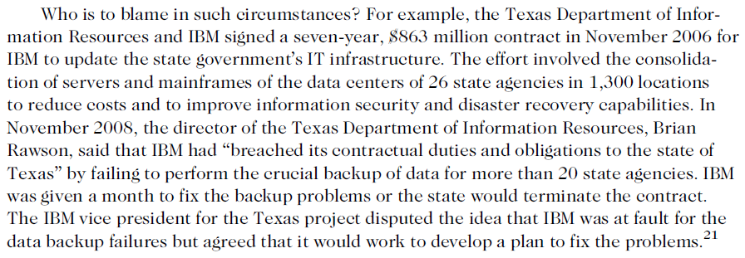
Relationships Between
IT Workers and Clients (cont’d.)
Breach of contract
Ethics in Information Technology, Fourth Edition
Notes:
Breach of contract : الإخلال بالعقد
One party fails : فشل طرف واحد
non-breaching: غير المخل // rescind : فسخ // restitution :تعويض //compensation : تعويضات
discharged : غير مكلف
further performance: مزيد من الأداء
vendors : البائعين
assign : حدد

Slide 28
3. Relationships Between
IT Workers and Suppliers
Develop good working relationships with suppliers:
  To encourage flow of useful information and ideas to develop innovative and cost-effective ways of using the supplier in ways that the IT worker may not have considered
  By dealing fairly with them
  By not making unreasonable demands
  Threatening behaviour
  Suppliers may strive to make good relationship-to increase sale – unethical actions to achieve this goal
    Offering IT worker a gift - bribe
Ethics in Information Technology, Fourth Edition
Notes:
encourage : شجع // innovative : مبتكرة //considered: يعتبر
unreasonable : غير معقول // demands:مطالب

Slide 29
Relationships Between
IT Workers and Suppliers (cont’d.)
Bribery
  Providing money, property, or favors to obtain a business advantage
  U.S. Foreign Corrupt Practices Act (FCPA): crime to bribe a foreign official, a foreign political party official, or a candidate for foreign political office
  At what point does a gift become a bribe?
  No gift should be hidden
  Perceptions of donor and recipient can differ
  United Nations Convention Against Corruption is a global treaty to fight bribery and corruption
Ethics in Information Technology, Fourth Edition
Notes:
Bribery: رشوة // property: ممتلكات// favors : تفضل
Perceptions : المفاهيم// donor :المانح// Convention :اتفاقية// Corruption :فساد// treaty :معاهدة

Slide 30
Relationships Between
IT Workers and Suppliers (cont’d.)
  FCPA requires cooperation to meet accounting standards
  FCPA permits transactions made for routine government actions
    Paying bills, for power, processing visa etc
  KBR, a major global engineering, construction, and services company (formerly a part of Halliburton), confessed that it paid $180 million in consulting fees to two agents to bribe Nigerian officials to gain a construction contract. KBR pled guilty to violating the FCPA and paid a $402 million fine.
Ethics in Information Technology, Fourth Edition
Notes:
Bribery: رشوة // property: ممتلكات// favors : تفضل
Perceptions : المفاهيم// donor :المانح// Convention :اتفاقية// Corruption :فساد// treaty :معاهدة

Slide 31
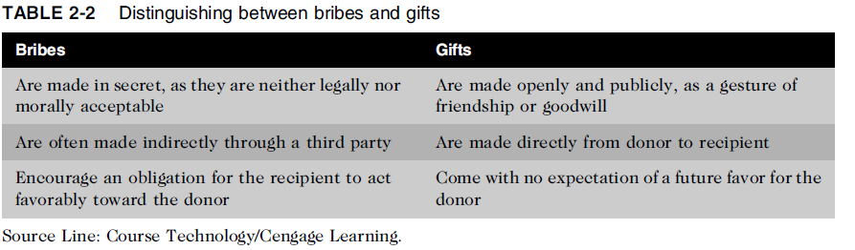
Relationships Between
IT Workers and Suppliers (cont’d.)
Ethics in Information Technology, Fourth Edition
Notes:
Obligation:التزام
Favorably:بشكل إيجابي:

Slide 32
4. Relationships Between
IT Workers and Other Professionals
Professionals feel a degree of loyalty to other members of their profession
Professionals owe each other adherence to their profession’s code of conduct
Senior members as mentors
Ethical problems among the IT profession
  Résumé inflation on 30% of U.S. job applications
    Short term benefit-but hurts profession
  Inappropriate sharing of corporate information
    Information might be sold intentionally or shared informally with those who have no need to know
Ethics in Information Technology, Fourth Edition
Notes:
owe : ندين //adherence : التزام //inflation : التضخم
Inappropriate :غير ملائم //sold intentionally :تباع عمدا//

Slide 33
5. Relationships Between
IT Workers and IT Users
IT user: person using a hardware or software product
IT workers’ duties
  Understand users’ needs and capabilities
  Deliver products and services that meet those needs
  Establish environment that supports ethical behavior:
    To discourages software piracy
    To minimize inappropriate use of corporate computing resources
    To avoid inappropriate sharing of information
Ethics in Information Technology, Fourth Edition
Notes:
inappropriate : غير ملائم

Slide 34
6. Relationships Between
IT Workers and Society
Society expects members of a profession:
  To provide significant benefits
  To not cause harm through their actions
Actions of an IT worker can affect society
Professional organizations provide codes of ethics to guide IT workers’ actions
Maintain professional standards that protect public
Ethics in Information Technology, Fourth Edition
Notes:
significant :هام //

Slide 35
6. Relationships Between
IT Workers and Society
Clearly, the actions of an IT worker can affect society. For example, a systems analyst may design a computer-based control system to monitor a chemical manufacturing process. A failure or an error in the system may put workers or residents near the plant at risk.
No single formal organization for establishing standards
Ethics in Information Technology, Fourth Edition
Notes:
significant :هام //

Slide 36
Professional Codes of Ethics
State the principles and core values that are essential to the work of an occupational group
Law does not cover all ethical behaviors
Most codes of ethics include:
  What the organization aspires to become
  Rules and principles by which members of the organization are expected to abide
Many codes also include commitment to continuing education for those who practice the profession
Ethics in Information Technology, Fourth Edition
Notes:
occupational مهني // aspires :يطمح
abide :التزم , التقيد

Slide 37
Professional Codes of Ethics
(cont’d.)
Following a professional code of ethics can produce benefits for the individual, the profession, and society as a whole
  Ethical decision making
    Common set of core values and beliefs
  High standards of practice and ethical behavior
  Trust and respect from general public
    Tell the truth-avoid giving self serving advice-offer warnings about side possible side effects
  Evaluation benchmark for self-assessment
Ethics in Information Technology, Fourth Edition

Slide 38
Professional Organizations
No universal code of ethics for IT professionals
No single, formal organization of IT professionals has emerged as preeminent
Five of the most prominent organizations include:
  Association for Computing Machinery (ACM)
  Institute of Electrical and Electronics Engineers Computer Society (IEEE-CS)
  Association of IT Professionals (AITP)
  SysAdmin, Audit, Network, Security (SANS) Institute
Ethics in Information Technology, Fourth Edition
Notes:
universal : عالمي //emerged : ظهرت // preeminent: بارزة // prominent :شهير

Slide 39
Certification
Indicates that a professional possesses a particular set of skills, knowledge, or abilities in the opinion of the certifying organization
Can also apply to products
Generally voluntary unlike licensing
May or may not require adherence to a code of ethics unlike licensing
Employers view as benchmark of knowledge
Opinions are divided on value of certification – not substitute for experience
Ethics in Information Technology, Fourth Edition
Notes:
Voluntary: طوعي // adherence التزام //benchmark : مؤشر

Slide 40
Certification (cont’d.)
Vendor certifications (CISCO IBM MICROSOFT)
  Certified users of vendor’s product
  Some certifications substantially improve IT workers’ salaries and career prospects
  Relevant for narrowly defined roles or certain aspects of broader roles
    Focus of vendor’s technology
  Require passing a written exam, or in some cases, a hands-on lab to demonstrate skills and knowledge
  Can take years to obtain necessary experience
  Training can be expensive
Ethics in Information Technology, Fourth Edition
Notes:
substantially :جوهريا, بصورة ملحوظة // narrowly : بصورة محدودة

Slide 41
Certification (cont’d.)
Industry association certifications
  Require a higher level of experience and a broader perspective than vendor certifications
  Must sit for and pass written exam
  May need to pay annual renewal fee, earn continuing education credits, and/or pass renewal test
  Lag in developing tests that cover new technologies
  Are moving from purely technical content to a broader mix of technical, business, and behavioral competencies
    Certifications in project management and network security
Ethics in Information Technology, Fourth Edition

Slide 42
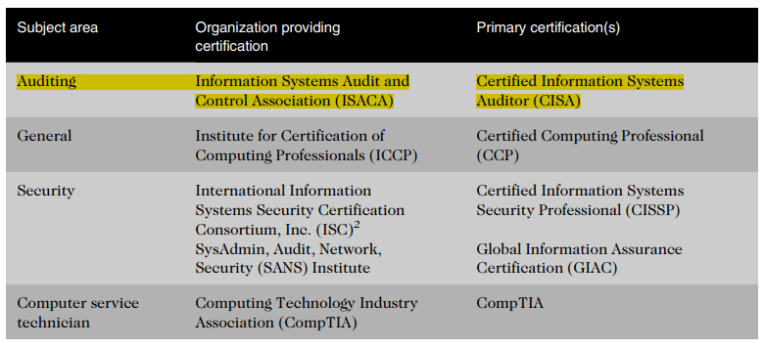
Certification (cont’d.)
Ethics in Information Technology, Fourth Edition

Slide 43
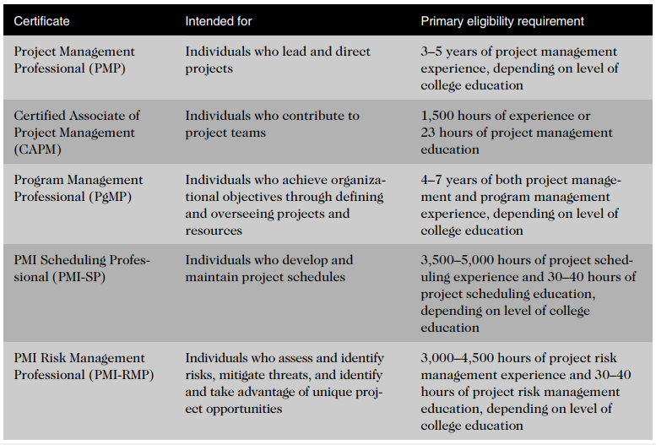
PMI - Certification (cont’d.)
Ethics in Information Technology, Fourth Edition

Slide 44
Government Licensing
License is a government-issued permission to engage in an activity or operate a business
Generally administered at the state level in the United States
Often requires that recipient pass a test
Some professionals must be licensed – doctors, lawyers, CPAs, medical and day care providers, engineers
One goal: protect public safety
Ethics in Information Technology, Fourth Edition

Slide 45
Government Licensing (cont’d.)
Case for licensing IT workers
  Encourages following highest standards of profession
  Encourages practicing a code of ethics
  Violators would be punished
Without licensing, there are no requirements for heightened care and no concept of professional malpractice
Ethics in Information Technology, Fourth Edition
Notes:
Violators : المخالفين
professional malpractice: سوء الممارسة المهنية
Malpractice: تزوير

Slide 46
Government Licensing (cont’d.)
Issues associated with government licensing of IT workers
    No universally accepted core body of knowledge
      No universally accepted standards licensing programmers, software engineers
      Professional societies, state agencies, federal government have developed their own standards
    Unclear who should manage content and administration of licensing exams
      Rapidly changing field – renewal of license
Ethics in Information Technology, Fourth Edition
Notes:
Issues associated : القضايا المرتبطة

Slide 47
Government Licensing (cont’d.)
Issues associated with government licensing of IT workers
    No administrative body to accredit professional education programs
      Not well defined step-by-step to train IT workers
      Not broad agreement, for even programmer must possess skills
    No administrative body to assess and ensure competence of individual workers
      Demonstrating incompetence – lose their license
Ethics in Information Technology, Fourth Edition
Notes:
Issues associated : القضايا المرتبطة

Slide 48
IT Professional Malpractice
Negligence: not doing something that a reasonable person would do, or doing something that a reasonable person would not do
Duty of care: obligation to protect people against any unreasonable harm or risk
  Reasonable person standard
  Reasonable professional standard
Ethics in Information Technology, Fourth Edition
Notes:
IT Professional Malpractice :
Negligence الإهمال:
reasonable : معقول
Duty of care: واجب الرعاية
obligation : التزام , واجب
Professional malpractice: سوء الممارسة المهنية:
breach : خرق , مخالفة

Slide 49
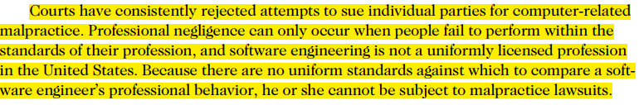
IT Professional Malpractice
Breach of duty of care:
  Failure to act as a reasonable person would act
  Police officer not protecting from an attacker
Professional malpractice: professionals who breach the duty of care are liable for injuries that their negligence causes – CPA fails to audit clients book is liable for accounting malpractice
Ethics in Information Technology, Fourth Edition
Notes:
IT Professional Malpractice :
Negligence الإهمال:
reasonable : معقول
Duty of care: واجب الرعاية
obligation : التزام , واجب
Professional malpractice: سوء الممارسة المهنية:
breach : خرق , مخالفة

Slide 50
IT Users
Employees’ ethical use of IT is an area of growing concern because of increased access to:
  Personal computers
  Corporate information systems and data
  The Internet
Ethics in Information Technology, Fourth Edition
Notes:
Corporate:

Slide 51
Common Ethical Issues for IT Users
Software piracy
  In corporate setting, traceable to IT professionals
  Copy software from work to work from home
Inappropriate use of computing resources
  Erodes productivity and wastes time
    Chat rooms, social networking, play games
Inappropriate sharing of information, including:
  Every organization stores vast amounts of private or confidential data
    Private data (employees and customers)
    Confidential information (company and operations)
Ethics in Information Technology, Fourth Edition
Notes:
Erodes : يضعف
Lawsuits: الدعاوى القضائية
vast : كبير , ضخم

Slide 52
Supporting the Ethical Practices of
IT Users
Policies that protect against abuses:
  Set forth general rights and responsibilities of users
  Create boundaries of acceptable behaviour
  Enable management to punish violators
  Can improve services to users – increase productivity
  Guidelines for IT usage policy making (next slide)
Ethics in Information Technology, Fourth Edition
Notes:
Abuses: انتهاكات
Violators: المخالفين

Slide 53
Supporting the Ethical Practices of
IT Users
Policy components include:
  Establishing guidelines for use of company software
    Negotiate contracts with software manufacturers to provide PCs and Software to work from home
    Corporate discount rate
  Defining appropriate use of IT resources
  Structuring information systems to protect data and information
  Installing and maintaining a corporate firewall
Ethics in Information Technology, Fourth Edition
Notes:
Abuses: انتهاكات
Violators: المخالفين

Slide 54
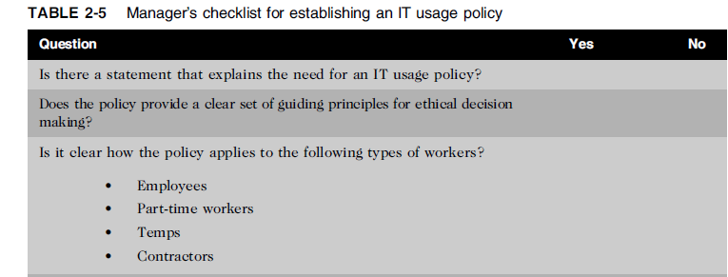
Supporting the Ethical Practices of
IT Users (cont’d.)
Ethics in Information Technology, Fourth Edition
Notes:
Temps: المؤقتين:

Slide 55
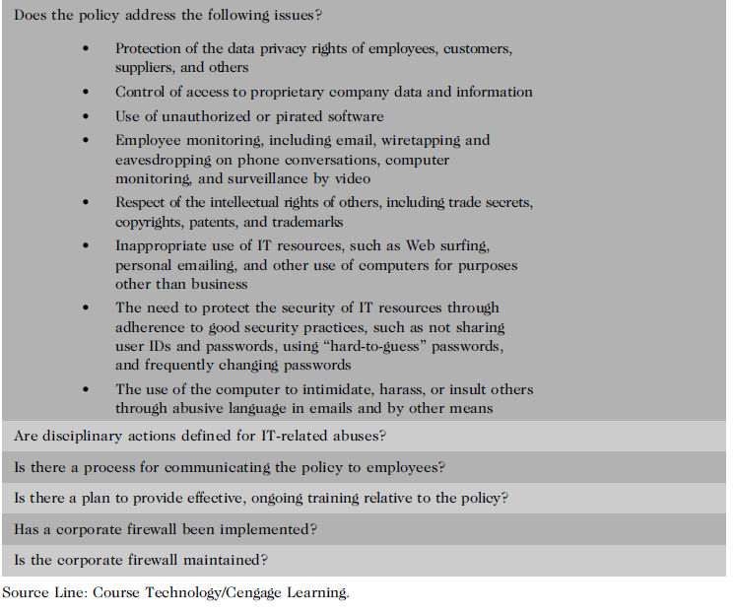
Ethics in Information Technology, Fourth Edition
Notes:
Pirated software:البرمجيات المقرصنة:
Wiretapping:التنصت
Eavesdropping: التنصت:
Surveillance: المراقبة:
adherence

Slide 56
Compliance
To be in accordance with established policies, guidelines, specifications, and legislation
  Sarbanes-Oxley Act – established requirements for internal controls
  HIPAA – ensures security and privacy of employee healthcare data
  Failure to be in conformance can lead to criminal or civil penalties and also lawsuits
Ethics in Information Technology, Fourth Edition
Notes:
Compliance:
Legislation تشريع , القانون

Slide 57
Compliance (cont’d.)
Major challenge to comply with multiple government and industry regulations that are sometimes in conflict
To meet this challenge:
  Implement software to track and record compliance actions
  Hire management consultants for advice and training
  Create Chief Compliance Officer position
Ethics in Information Technology, Fourth Edition

Slide 58
Compliance (cont’d.)
Audit committee is subset of the board of directors, with oversight for the following activities:
  Quality and integrity of accounting and reporting practices and controls
  Compliance with legal and regulatory requirements
  Qualifications, independence, and performance of organization’s independent auditor
  Performance of company’s internal audit team
Ethics in Information Technology, Fourth Edition
Notes:
committee لجنة

Slide 59
Compliance (cont’d.)
Internal audit committee responsibilities:
  Determine that internal systems and controls are adequate and effective
  Verify existence of company assets and maintain proper safeguards over their protection
  Measure the organization’s compliance with its own policies and procedures
  Insure that institutional policies and procedures, appropriate laws, and good practices are followed
  Evaluate adequacy and reliability of information available for management decision making
Ethics in Information Technology, Fourth Edition

Slide 60
Summary
Professionals
  Require advanced training and experience
  Must exercise discretion and judgment in their work
  Their work cannot be standardized
From a legal standpoint, a professional:
  Has passed the state licensing requirements
  Has earned the right to practice in a state(s)
IT professionals have many different relationships
  Each with its own ethical issues and potential problems
Ethics in Information Technology, Fourth Edition

Slide 61
Summary (cont’d.)
Professional code of ethics
  States the principles and core values essential to the work of an occupational group
  Serves as a guideline for ethical decision making
  Promotes high standards of practice and behavior
  Enhances trust and respect from the general public
  Provides an evaluation benchmark
Licensing and certification of IT professionals
  Would increase the reliability and effectiveness of information systems
  Raises many issues
Ethics in Information Technology, Fourth Edition

Slide 62
Summary (cont’d.)
IT-related professional organizations have developed their code of ethics that:
  Outlines what the organization aspires to become
  Lists rules and principles for members
  Includes a commitment to continuing education for those who practice the profession
Audit committee and internal audit team have a major role in ensuring that both the IT organization and IT users are in compliance with guidelines and various legal and regulatory practices
Ethics in Information Technology, Fourth Edition

